Slide 1

Defining Classes
Encapsulation and Inheritance
SoftUni Team
Technical Trainers
Software University
http://softuni.bg

Slide 2
Table of Contents
Encapsulation
Keyword $this
Access modifiers
Inheritance
Class hierarchies
Inheritance and access levels
Exceptions
Handling Exceptions

Slide 3
Have a Question?
sli.do #php-web

Slide 4
Keyword
const - It is possible to define constant values on a per-class basis remaining the same and unchangeable. Constants differ from normal variables in that you don't use the $ symbol to declare or use them. The default visibility of class constants is public. The value must be a constant expression, not (for example) a variable, a property, or a function call. It is also possible that the interfaces we will learn in the next lecture have constants.
static - Declaring class properties or methods as static makes them accessible without needing an instantiation of the class. A property declared as static cannot be accessed with an instantiated class object (though a static method can).
final - PHP 5 introduces the final keyword, which prevents child classes from overriding a method by prefixing the definition with final. If the class itself is being defined final then it cannot be extended

Slide 5
Two Fundamental Principles of OOP
Encapsulation – the object as a black box
Hide internal data
Reach internal data by Setters and Getters
Inheritance – classes in relations
Inherit members from parent class
Call a constructor from parent class

Slide 6
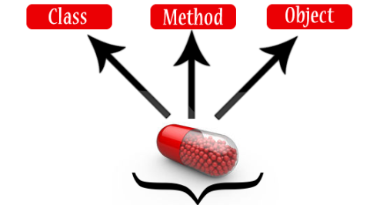
Encapsulation

Slide 7
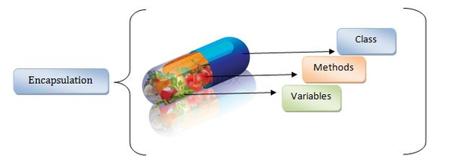
Encapsulation
Encapsulation - wrapping up related data and methods in one module.
Restrict the direct access to members by using setters and getters

Slide 8

Visibility and Encapsulation
Parent Child Grandchild Global scope
private
protected
public

Slide 9
Keyword this
this is reference to the current object
this can refer current class instance variable
this can invoke current class method
public function __construct(string $name) {
this->name = $name;
}
public function fullName() {
return this->getFirstName() . " " . this->getLastName()
}
Notes:
Constructors are declared public
Constructors perform checks to keep the object state valid
Interface methods are always public
Not explicitly declared with public
Non-interface methods are declared private / protected

Slide 10
Visibility
There are three visibility levels in PHP
Available only to the class and its
children
class Person {
protected $age;
private $gender;
public function __construct($age, $gender) {
$this->setAge($age);
$this->setGender($gender);
}
public function setAge($age) {
$this->age = $age;
}
Available only to the class itself
Available
everywhere

Slide 11
Visibility (2)
public function setGender($gender) {
$this->gender = $gender;
}
public function getGender() {
return $this->gender;
}
public function getAge() {
return $this->age;
}
}
$newPerson = new Person(12, "male");
echo $newPerson->getGender();

Slide 12
Getters and Setters
You can define your own setters and getters
Using getters and setters you can control data validation
public function getAge() {
return $this->age;
}
public function setAge($age) {
if ($age < 18)
throw new Exception('Should be an adult');
else
$this->age = $age;
}

Slide 13
Magic Setters and Getters
__set() is run when writing data to inaccessible properties
__get() is utilized for reading data from inaccessible properties
Data validation is not so flexible this way
public function __set($name, $value) {
$this->{$name} = $value;
}
public function __get($name) {
return $this->{$name};
}

Slide 14
Problem: Employee Class
Every Employee should have:
First and last name
Salary and age
Salary should not be visible outside the class but visible for child classes
Salary should be bigger than 0 and must have a way to increase that salary. Lowest increase is 10%
Every employee should be at least 16 years old

Slide 15
Solution: Employee Class
class Employee {
public $fname;
public $lname;
protected $salary;
private $age;
public function __construct($fname, $lname, $age, $salary) {
$this->fname = $fname;
$this->lname = $lname;
$this->setSalary($salary);
$this->setAge($age);
}

Slide 16
Solution: Employee Class (2)
public function increaseSalary($increase) {
if ($increase < 10) {
throw new Exception('Invalid increase');
}
$this->salary *= (1 + $increase / 100);
}
public function setSalary($salary) {
if ($salary < 1) {
throw new Exception('Invalid salary');
}
$this->salary = $salary;
}

Slide 17
Solution: Employee Class (3)
public function setAge($age) {
if ($age < 16) {
throw new Exception('Invalid age');
}
$this->age = $age;
}
}
$employee = new Employee('Gosho','Petrov',25,5000);
$employee->increaseSalary(15);

Slide 18


Encapsulation
Live Exercises in Class (Lab, part 1)

Slide 19
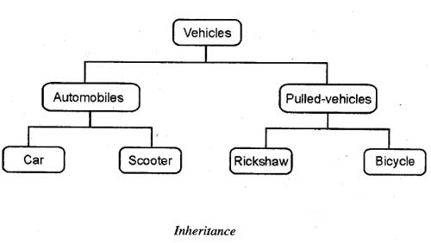
Class Inheritance

Slide 20
Class Inheritance
Base (parent, super) class
Classes can inherit (extend) other classes
Child class inherits data + methods from its parent
Child class can:
Add properties (data)
Add / replace methods
Add / replace accessor properties
Person
name
email
Child (derived) class
Teacher
subject

Slide 21
Class Inheritance – Example
class Person {
function __construct($name, $email) {
$this->name = $name;
$this->email = $email;
}
}
Person
name
email
class Teacher inherits Person
class Teacher extends Person {
function __construct($name, $email, $subject) {
parent::__construct($name, $email);
$this->subject = $subject;
}
}
Teacher
subject
Invoke the parent constructor

Slide 22
Class Inheritance – Example (2)
$p = new Person("Maria", "maria@gmail.com");
echo "Person: " .
$p->name . ' (' . $p->email . ')';
// Person: Maria (maria@gmail.com)
$t = new Teacher("Ivan", "iv@yahoo.com", "PHP");
echo "Teacher: " . $t->name .
' (' . $t->email . '), teaches ' . $t->subject .')';
// Teacher: Ivan (iv@yahoo.com), teaches PHP

Slide 23
Person
name
email
__toString()
Teacher
Student
subject
course
__toString()
__toString()
Accessing Parent Members
Invoking Parent Methods

Slide 24
Inheriting and Replacing __toString() – Person
class Person {
function __construct($name, $email) {
$this->name = $name;
$this->email = $email;
}
function __toString() {
$className = get_class($this);
return $className . '(name: ' . $this->name . ', email: ' . $this->email . ')';
}
}
More magic methods: http://php.net/manual/en/language.oop5.magic.php

Slide 25
Inheriting and Replacing __toString() – Teacher
class Teacher extends Person {
function __construct($name, $email, $subject) {
parent::__construct($name, $email);
$this->subject = $subject;
}
function __toString() {
$parentString = parent::__toString();
return $parentString . ' subject: ' . $this->subject . ')';
}
}
Invoke __toString() from the base (parent) class

Slide 26
Inheriting and Replacing __toString() – Student
class Student extends Person {
function __construct($name, $email, $course) {
parent::__construct($name, $email);
$this->course = $course;
}
function __toString() {
$parentString = parent::__toString();
return $parentString . ' course: ' . $this->course . ')';
}
}
Invoke __toString() from the base (parent) class

Slide 27
Inheriting and Replacing toString() – Usage
$p = new Person("Maria", "maria@gmail.com");
echo $p;
// Person (name: Maria, email: maria@gmail.com)
$t = new Teacher("Ivan", "iv@yahoo.com", "PHP");
echo $t;
// Teacher (name: Ivan, email: iv@yahoo.com, subject: PHP)
$s = new Student("Ana", "ana@mail.ru", 3);
echo $s;
// Student (name: Ana, email: ana@mail.ru, course: 3)

Slide 28
Inheritance: Important Aspects
There is no multiple inheritance
Constructors are not inherited
Parent constructors are not called implicitly by the engine
Extended class could add new members, but couldn’t remove derived members
New members with the same name hide the inherited ones
Private members are accessible through the parent setters and getters
Public and Protected members are overwritten

Slide 29
Inheritance
Live Exercises in Class (Lab, part 2)

Slide 30
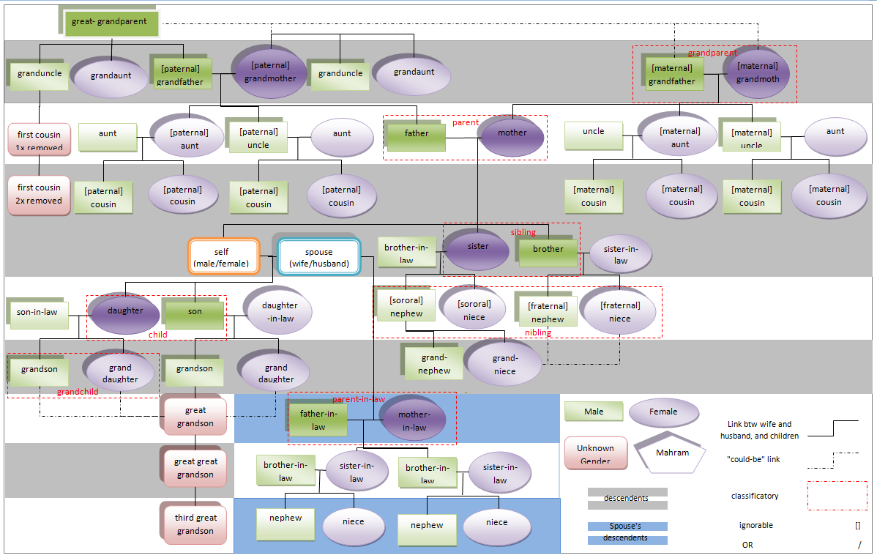

Avoid the Over-Inheritance Trap
A large hierarchy of classes may become non-maintainable
A class is like a scheme or template, so do not extend classes for minor changes
Let the hierarchy model the real-world objects / connections

Slide 31
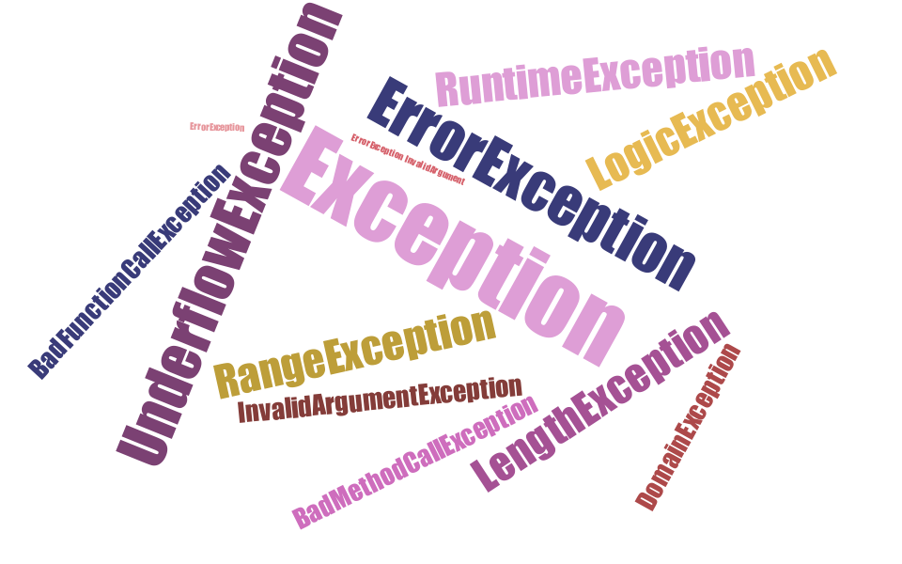
Exceptions

Slide 32
What are Exceptions?
Exceptions are a powerful mechanism for centralized handling of errors and unusual events
This is what normally happens when an exception is triggered:
The current code state is saved
The code execution will switch to a predefined (custom) exception handler function
Depending on the situation, the handler may then resume the execution from the saved code state, terminate the script execution or continue the script from a different location in the code

Slide 33
Exception - Example
public function setAge($age) {
if ($age < 16) {
throw new Exception('Invalid age');
}
$this->age = $age;
}

Slide 34
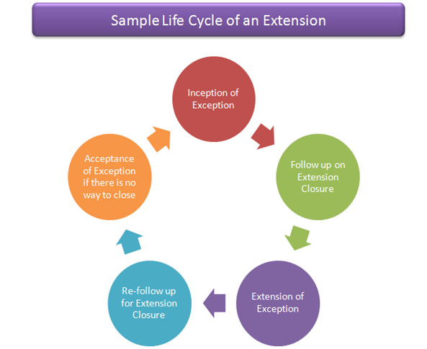
Handling Exceptions

Slide 35
Exception - Keywords
Exceptions are important and provides a better control over error handling.
Lets explain there new keyword related to exceptions.
Try − A function using an exception should be in a "try" block. If the exception does not trigger, the code will continue as normal. However if the exception triggers, an exception is "thrown".
Throw − This is how you trigger an exception. Each "throw" must have at least one "catch".
Catch − A "catch" block retrieves an exception and creates an object containing the exception information.

Slide 36
Example
<?php
try {
$error = 'Always throw this error';
throw new Exception($error);
// Code following an exception is not executed.
echo 'Never executed';
} catch (Exception $e) {
echo 'Caught exception: ', $e->getMessage(), "\n";
}
// Continue execution
echo 'Hello World';
?>

Slide 37
Exception
In the above example $e->getMessage function is used to get error message. There are following functions which can be used from Exception class.
getMessage() − message of exception
getCode() − code of exception
getFile() − source filename
getLine() − source line
getTrace() − n array of the backtrace()
getTraceAsString() − formated string of trace

Slide 38
The try-catch Statement
Catching a certain exception types only:
try
{
// Do some work that can cause an exception
}
catch (Exception $exeption)
{
// This block will execute only if format exception occurs
}

Slide 39
The try-finally Statement
Ensures execution of given block in all cases
When exception is raised or not in the try block
Used for execution of cleaning-up code, e.g. releasing resources
try
{
// Do some work that can cause an exception
}
finally
{
// This block will always execute
}

Slide 40
The try-catch-finally Statement
try
{
// Do some work that can cause an exception
}
catch(Exception $fileNotFoundEx)
{
// This block will be executed only if
// "file not found" exception occurs
}
finally
{
// This block will always execute
}

Slide 41

Summary
Abstraction
Reduces complexity
Encapsulation
Hides internal data
Ensures that structural changes remain local
Access modifiers
Inheritance allows extending the behavior of the classes
Inheriting properties
Inheriting methods
Reusing the existing code

Slide 43












SoftUni Diamond Partners

Slide 44




SoftUni Organizational Partners

Slide 45




Trainings @ Software University (SoftUni)
Software University – High-Quality Education and Employment Opportunities
softuni.bg
Software University Foundation
http://softuni.foundation/
Software University @ Facebook
facebook.com/SoftwareUniversity
Software University Forums
forum.softuni.bg

Slide 46

License
This course (slides, examples, demos, videos, homework, etc.) is licensed under the "Creative Commons Attribution-NonCommercial-ShareAlike 4.0 International" license

